Slide 1
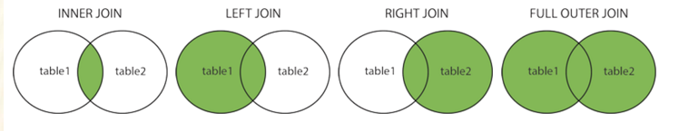
Joins
Cartesian product
Self Join
Inner Join
Theta Join
Equijoin
NATURAL JOIN
Semi Join
Anti Join
Outer Join

Slide 2
Product, A x B
Binary operation – applies to two tables
Cartesian product; cross-product of A and B; A TIMES B, written A x B
Concatenates all rows of A with all rows of B
Columns are the columns of A followed by the columns of B
Degree of result is deg of A + deg of B
Cardinality of result is (card of A) * (card of B)
Join operations take two relations and return as a result another relation.
A join operation is a Cartesian product which requires that tuples in the two relations match (under some condition). It also specifies the attributes that are present in the result of the join

Slide 3
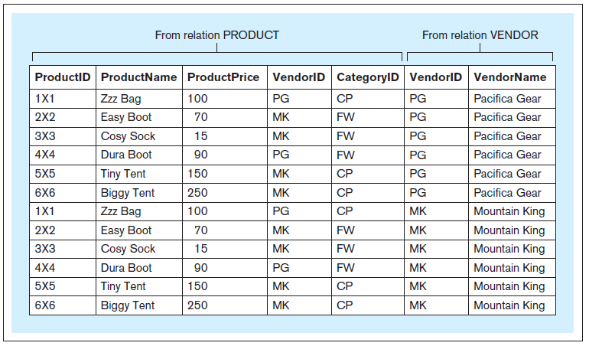
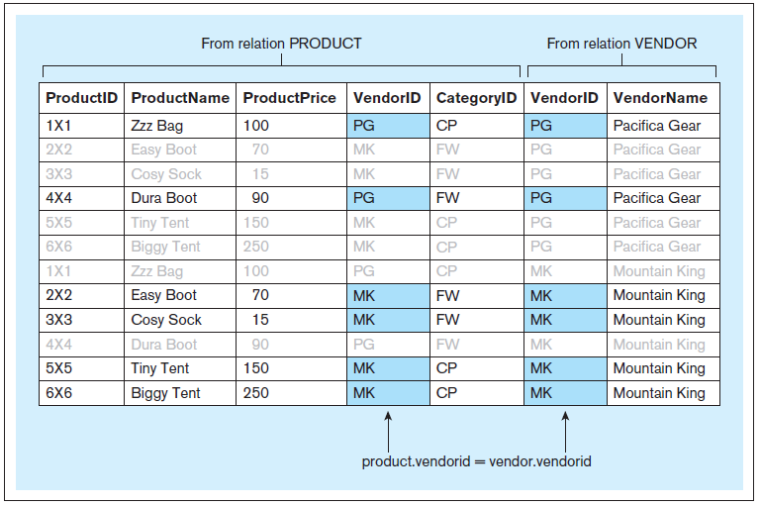
JOIN – Cartesian Product
Formation of the result of Query 34:
Notes:
This example is discussed on Pages 148-151.

Slide 4
The example
CREATE TABLE vendor
( vendorid CHAR(2) NOT NULL,
vendorname VARCHAR(25) NOT NULL,
PRIMARY KEY (vendorid) );
CREATE TABLE product
( productid CHAR(3) NOT NULL,
productname VARCHAR(25) NOT NULL,
productprice NUMERIC(7,2) NOT NULL,
vendorid CHAR(2) NOT NULL,
categoryid CHAR(2) NOT NULL,
PRIMARY KEY (productid),
FOREIGN KEY (vendorid) REFERENCES vendor(vendorid),
FOREIGN KEY (categoryid) REFERENCES category(categoryid) );

Slide 5
The example
Vendor & Produc
INSERT INTO vendor VALUES ('PG','Pacifica Gear');
INSERT INTO vendor VALUES ('MK','Mountain King');
INSERT INTO product VALUES ('1X1','Zzz Bag',100,'PG','CP');
INSERT INTO product VALUES ('2X2','Easy Boot',70,'MK','FW');
INSERT INTO product VALUES ('3X3','Cosy Sock',15,'MK','FW');
INSERT INTO product VALUES ('4X4','Dura Boot',90,'PG','FW');
INSERT INTO product VALUES ('5X5','Tiny Tent',150,'MK','CP');
INSERT INTO product VALUES ('6X6','Biggy Tent',250,'MK','CP');

Slide 6
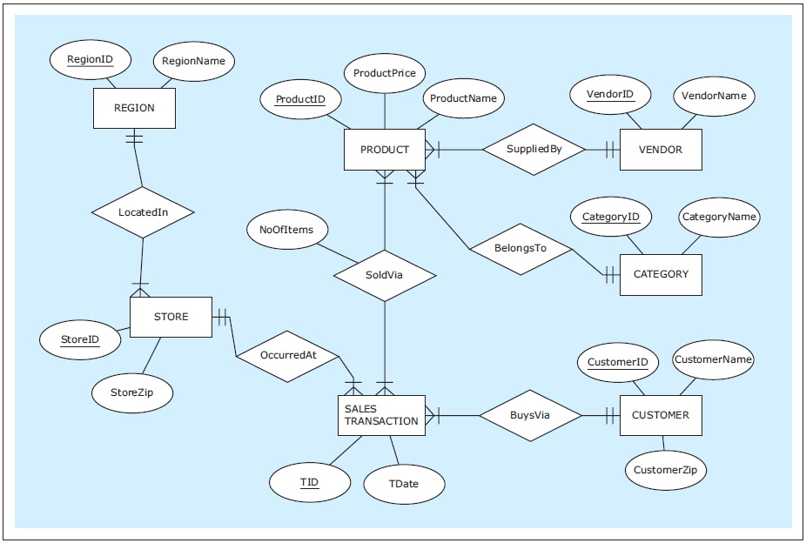

Slide 7
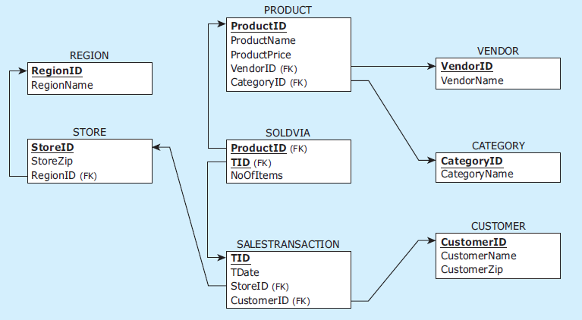
Relational schema: ZAGI Retail Company Sales Department Database
Notes:
This example is discussed on Page 70.

Slide 8
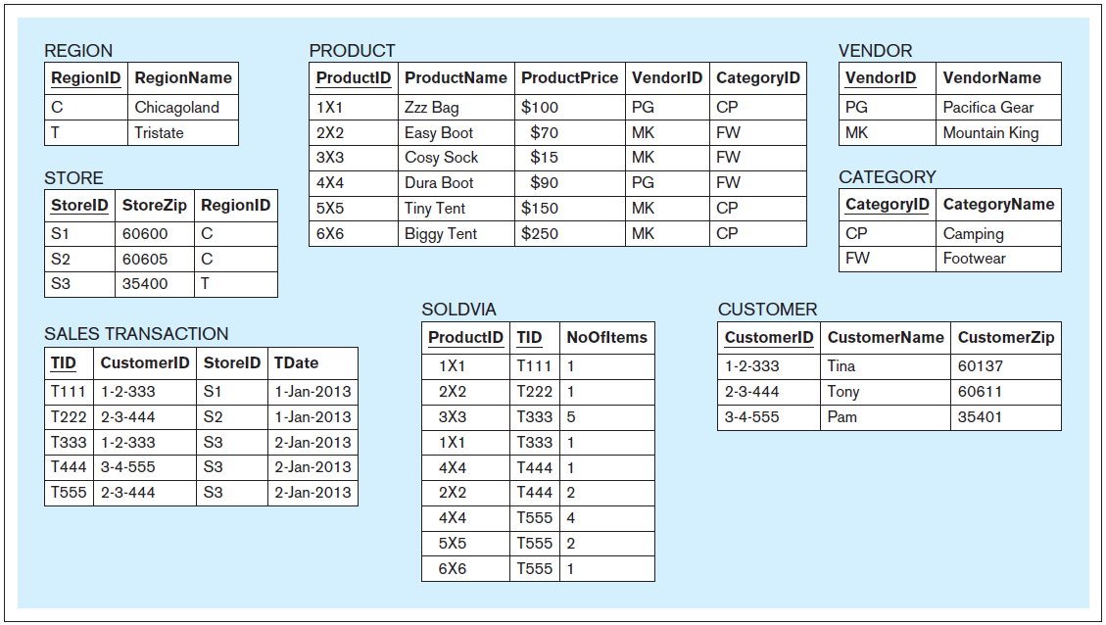
Data records: ZAGI Retail Company Sales Department Database
Notes:
This example is discussed on Page 70.

Slide 9
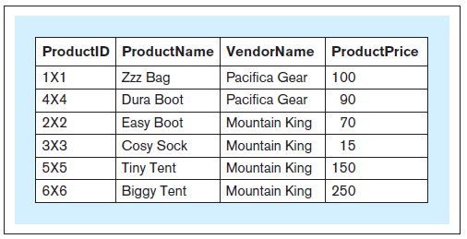
JOIN
Query 31 text: For each product, retrieve the product ID, name of the product, name of the vendor of the product, and price of the product
Query 31: SELECT productid, productname, vendorname, productprice FROM product, vendor WHERE product.vendorid = vendor.vendorid;
Query 31 result:
Notes:
This example is discussed on Pages 148-151.

Slide 10
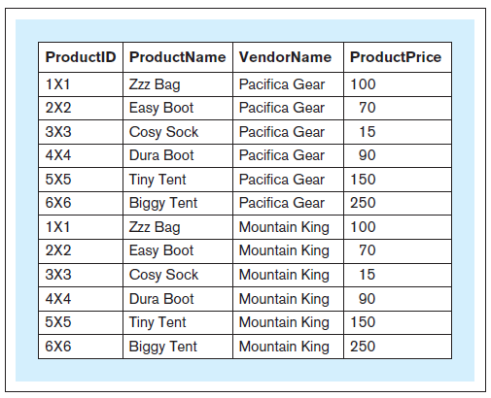
JOIN
Query 32: SELECT productid, productname, vendorname, productprice FROM product, vendor;
Notes:
This example is discussed on Pages 148-151.

Slide 11
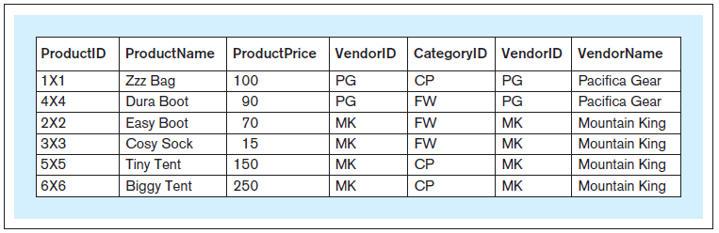
JOIN
Query 34:
SELECT * FROM product, vendor WHERE product.vendorid = vendor.vendorid;
Query 34 result:
Notes:
This example is discussed on Pages 148-151.

Slide 12
JOIN
Formation of the result of Query 34:
Notes:
This example is discussed on Pages 148-151.

Slide 13
ALIAS: Alias An alternative and usually shorter name that can be used anywhere within a query instead of the full relation name
Query 31a text: For each product, retrieve the product ID, name of the product, (same query) name of the vendor of the product, and price of the product
Query 31a: SELECT p.productid, p.productname, v.vendorname, p.productprice FROM product p, vendor v WHERE p.vendorid = v.vendorid;
Query 31a result: (same result)
Notes:
This example is discussed on Page 151.

Slide 14
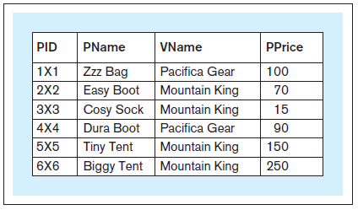
ALIAS
Query 31b text: For each product, retrieve the product id, name of the product, (same query) name of the vendor of the product, and price of the product
Query 31b: SELECT p.productid pid, p.productname pname, v.vendorname vname, p.productprice pprice FROM product p, vendor v WHERE p.vendorid = v.vendorid;
Query 31b result: (same result, different column names in the result)
Notes:
This example is discussed on Page 151.

Slide 15
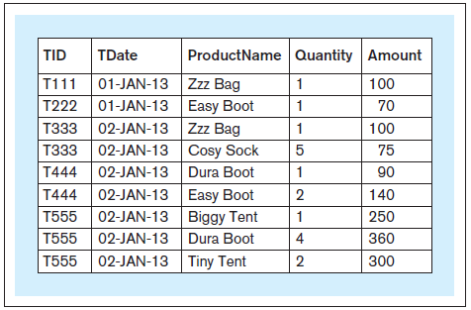
JOINING MULTIPLE RELATIONS A query can contain multiple JOIN conditions, joining multiple relations
Query 35 text: For each line item of a sales transaction, retrieve the transaction identifier, date of the transaction, name of the product that was sold, quantity sold, and amount charged
Query 35: SELECT t.tid, t.tdate, p.productname, sv.noofitems AS quantity, (sv.noofitems * p.productprice) AS amount FROM product p, salestransaction t, soldvia sv WHERE sv.productid = p.productid AND sv.tid = t.tid ORDER BY t.tid;
Query 35 result:
Notes:
This example is discussed on Page 152.

Slide 16
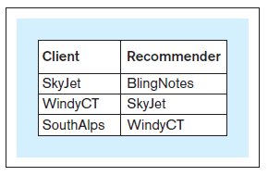
SELF-JOIN
A join statement that includes a relation that contains a foreign key referring to itself, and joins a relation with itself in a query
Query 39 text: For all corporate clients that were referred by other corporate clients, retrieve the name of the corporate client and the name of the corporate client that referred it
Query 39: SELECT c.ccname AS client, r.ccname AS recommender FROM corpclient c, corpclient r WHERE r.ccid = c.ccidreferredby;
Query 39 result:
Notes:
This example is discussed on Pages 163-164.

Slide 17
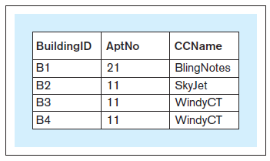
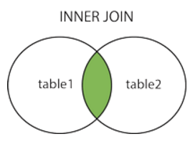
INNER JOIN
selects records that have matching values in both tables.
Query 40: SELECT a.buildingid, a.aptno, c.ccname FROM apartment a, corpclient c WHERE a.ccid = c.ccid;
OR:
SELECT Orders.OrderID, Customers.CustomerName FROM Orders INNER JOIN Customers ON Orders.CustomerID = Customers.CustomerID;
Notes:
This example is discussed on Pages 164-166.

Slide 18
INNER JOIN
SELECT Orders.OrderID, Customers.CustomerName, Shippers.ShipperName FROM (( Orders INNER JOIN Customers ON Orders.CustomerID = Customers.CustomerID) INNER JOIN Shippers ON Orders.ShipperID = Shippers.ShipperID);

Slide 19
Theta Join and Equijoin
Theta join is Product followed by a Select with predicate, theta (Θ)
A |x|_{θ} B = σ_{θ}(A x B)
Equijoin can be formed when tables have common columns, or columns with same domains
For equijoin, select rows of the product where the values of the common columns are equal

Slide 20
NATURAL JOIN
Same as Equijoin, but drop repeated column(s)
symbolized by |x| as in
[newTableName = ] Student |x| Enroll
or
Student JOIN Enroll [GIVING newTableName]

Slide 21
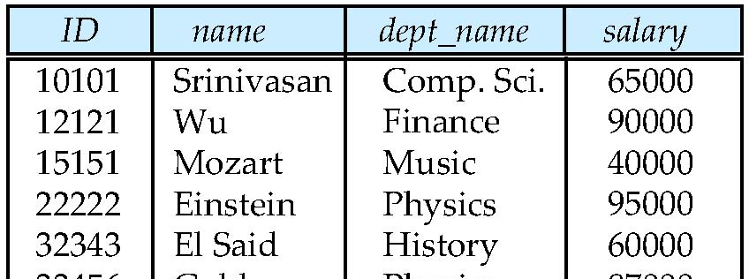
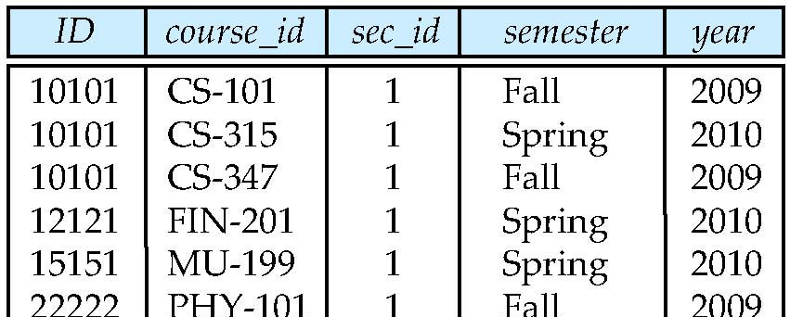
Natural Join Example
List the names of instructors along with the course ID of the courses that they taught.
select name, course_id from instructor, teaches where instructor.ID = teaches.ID;
select name, course_id from instructor natural join teaches;
instructor
teaches

Slide 22
Outer Join
An extension of the join operation that avoids loss of information.
Computes the join and then adds tuples form one relation that does not match tuples in the other relation to the result of the join. Uses null values.
Left outer join of A and B
Form natural join, but add rows for all the tuples of A with no matches in B
Fill in the B attributes for those unmatched tuples with null values
Right outer join of A and B
Add unmatched B tuples to natural join, filling in null values for the A attributes
Full outer join of A and B
Add unmatched tuples for both A and B, filling in null values for unmatched tuples on both sides

Slide 23
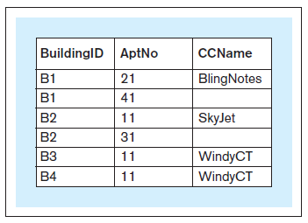
OUTER JOIN LEFT OUTER JOIN
Query 41: SELECT a.buildingid, a.aptno, c.ccname FROM apartment a LEFT OUTER JOIN corpclient c ON a.ccid = c.ccid;
Query 41 result:
Notes:
This example is discussed on Pages 164-166.

Slide 24
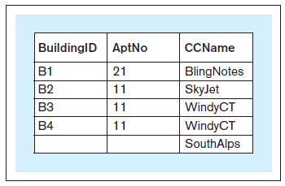
OUTER JOIN RIGHT OUTER JOIN
Query 42: SELECT a.buildingid, a.aptno, c.ccname FROM apartment a RIGHT OUTER JOIN corpclient c ON a.ccid = c.ccid;
Query 42 result:
Notes:
This example is discussed on Pages 164-166.

Slide 25
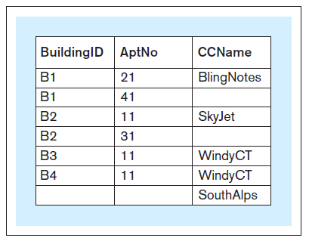
OUTER Join FULL OUTER JOIN
Query 43: SELECT a.buildingid, a.aptno, c.ccname FROM apartment a FULL OUTER JOIN corpclient c ON a.ccid = c.ccid;
Query 43 result:
Notes:
This example is discussed on Pages 164-166.

Slide 26
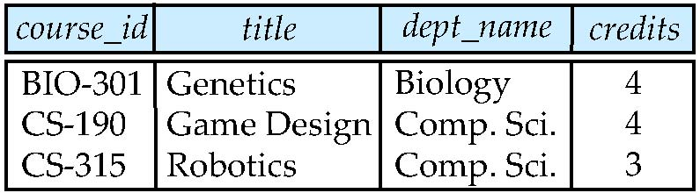
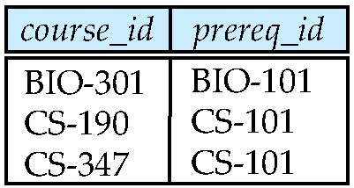
Join operations – Example
Relation course
Relation prereq
Observe that
prereq information is missing for CS-315 and
course information is missing for CS-437

Slide 27
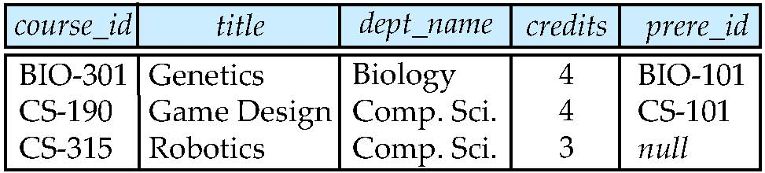
Left Outer Join
course natural left outer join prereq
course
prereq

Slide 28
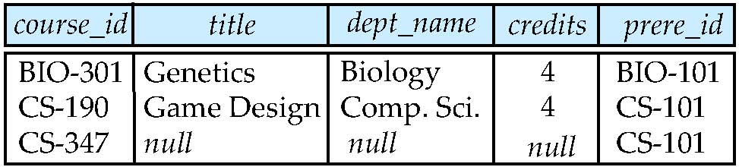
Right Outer Join
course natural right outer join prereq
course
prereq

Slide 29
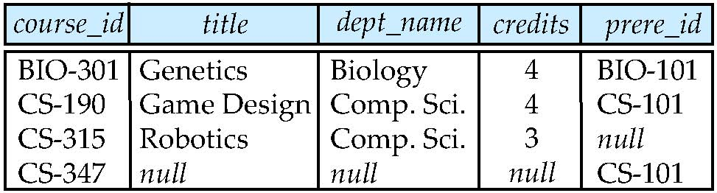
Full Outer Join
course natural full outer join prereq
course
prereq

Slide 30
JOIN WITHOUT USING A PRIMARY KEY/ FOREIGN KEY COMBINATION
Join without using a primary key/foreign key combination
It is possible to join two tables without joining a foreign key column in one table with a primary key column in another table.
A JOIN condition can connect a column from one table with a column from the other table as long as those columns contain the same values.

Slide 31
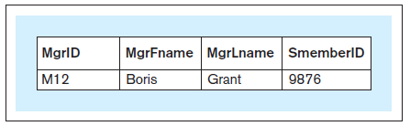
JOIN WITHOUT USING A PRIMARY KEY/FOREIGN KEY COMBINATION
Query 44 text: For each manager who has a staff member with the same name as the manager’s first name, show the manager’s ID, first name, and last name and the ID of the staff members who have the same name as the manager’s first name
Query 44: SELECT m.managerid, m.mfname, m.mlname, s.smemberid FROM manager m, staffmember s WHERE m.mfname = s.smembername;
Query 44 result:
Notes:
This example is discussed on Page 166.

Slide 32
Semi Join
A join where the results only contains the columns from one of the joined relations (left or right)
Semi-join strategies are techniques for query processing in distributed database systems
Used to reduce communication cost as smaller number of tubles is sent

Slide 33
Semi Join Formal Definition
The semijoin of r₁ with r₂, is denoted by:
r₁ r₂
it is defined by:
∏_{R1} (r₁ r₂)
Thus, r₁ r₂ selects those tuples of r₁ that contributed to r₁ r₂.
In step 3 above, temp₂=r₂ r₁.
Project tubles only from R1

Slide 34
Semi Join
Left-semijoin A |x B
take the natural join of A and B and then project the result onto the attributes of A
result is just those tuples of A that participate in the natural join
Right-semijoin A x| B
Projection onto B of the natural join A|x|B

Slide 35
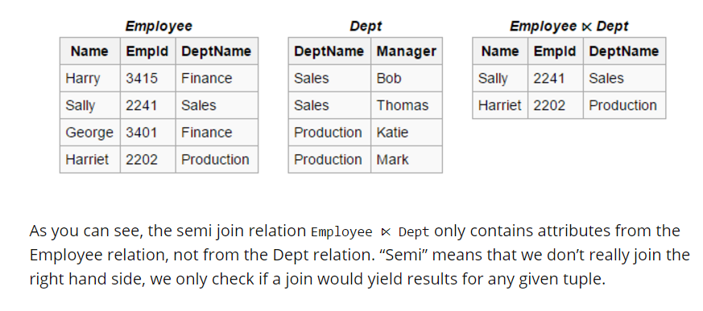
Semi-join example

Slide 36
Semi-join example – is implemented using EXISTS or IN
-- Natural semi join
SELECT *
FROM Employee
NATURAL LEFT SEMI JOIN Dept
-- Semi join with USING clause
SELECT *
FROM Employee
LEFT SEMI JOIN Dept USING (DeptName)
-- Semi join with ON clause
SELECT *
FROM Employee e
LEFT SEMI JOIN Dept d ON e.DeptName = d.DeptName
-- IN
SELECT *
FROM Employee
WHERE DeptName IN (
SELECT DeptName
FROM Dept
)
-- EXISTS
SELECT *
FROM Employee
WHERE EXISTS (
SELECT 1
FROM Dept
WHERE Employee.DeptName = Dept.DeptName
)

Slide 37
Semi-join example – is implemented using EXISTS or IN
“Give a list of departments with at least one employee”
Conventional join:
SELECT D.deptNo, D.Dname
FROM Department D, Employee E
WHERE E.deptNo = D.deptNo
ORDER BY D.deptNo;
Department with N employees will show up N times
Semi-Join Implementation:
SELECT D.deptNo, D.Dname
FROM Department D
WHERE EXISTS
(SELECT 1
FROM Employee E
WHERE E.deptNo = D.deptNo)
ORDER BY D.deptNo;
No Department appears more than once
Oracle STOPS processing as soon as the first employee in the department is found

Slide 38
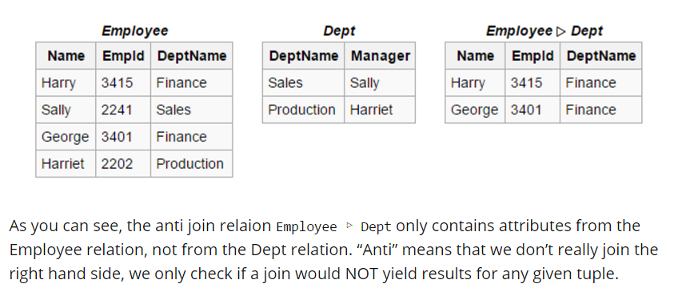
Anti join

Slide 39
ANTI-join example – is implemented using NOT EXISTS or NOT IN
In SQL, we would write the same relation using NOT IN or NOT EXISTS (although, in the case of NOT IN, we need to be extra careful with NULLs):
-- NOT IN
SELECT *
FROM Employee
WHERE DeptName NOT IN (
SELECT DeptName
FROM Dept
)
-- NOT EXISTS
SELECT *
FROM Employee
WHERE NOT EXISTS (
SELECT 1
FROM Dept
WHERE Employee.DeptName = Dept.DeptName
)
-- Natural anti join
SELECT *
FROM Employee
NATURAL LEFT ANTI JOIN Dept
-- Anti join with USING clause
SELECT *
FROM Employee
LEFT ANTI JOIN Dept USING (DeptName)
-- Anti join with ON clause
SELECT *
FROM Employee e
LEFT ANTI JOIN Dept d ON e.DeptName = d.DeptName

Slide 40
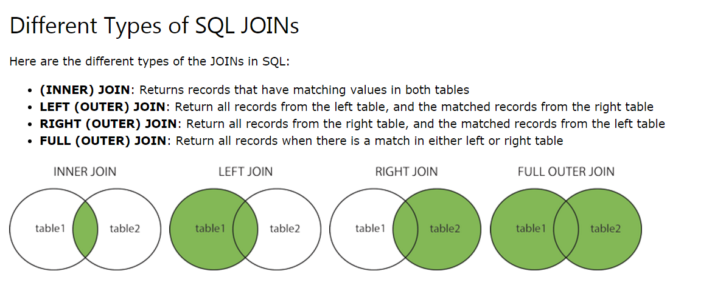
Useful resource
https://www.w3schools.com/sql/sql_join.asp

